Slide 2

Babble
100% Offline Chat

Slide 3
Babble
Offline
installation
setup
messaging

Slide 4
Babble
Designed for
Offline markets
Infrastructure Failure
Disaster situations

Slide 5


Slide 6


Slide 7

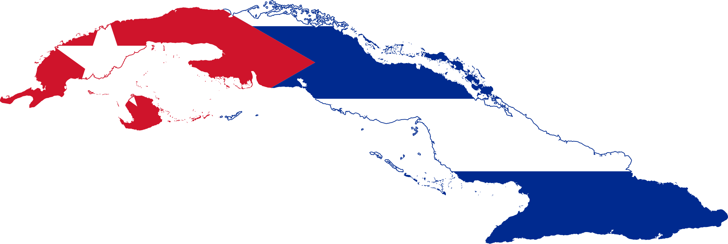

Messaging for internet limited countries:
Government Restriction
Inability to construct infrastructure
Embargo
Political Unrest

Slide 8
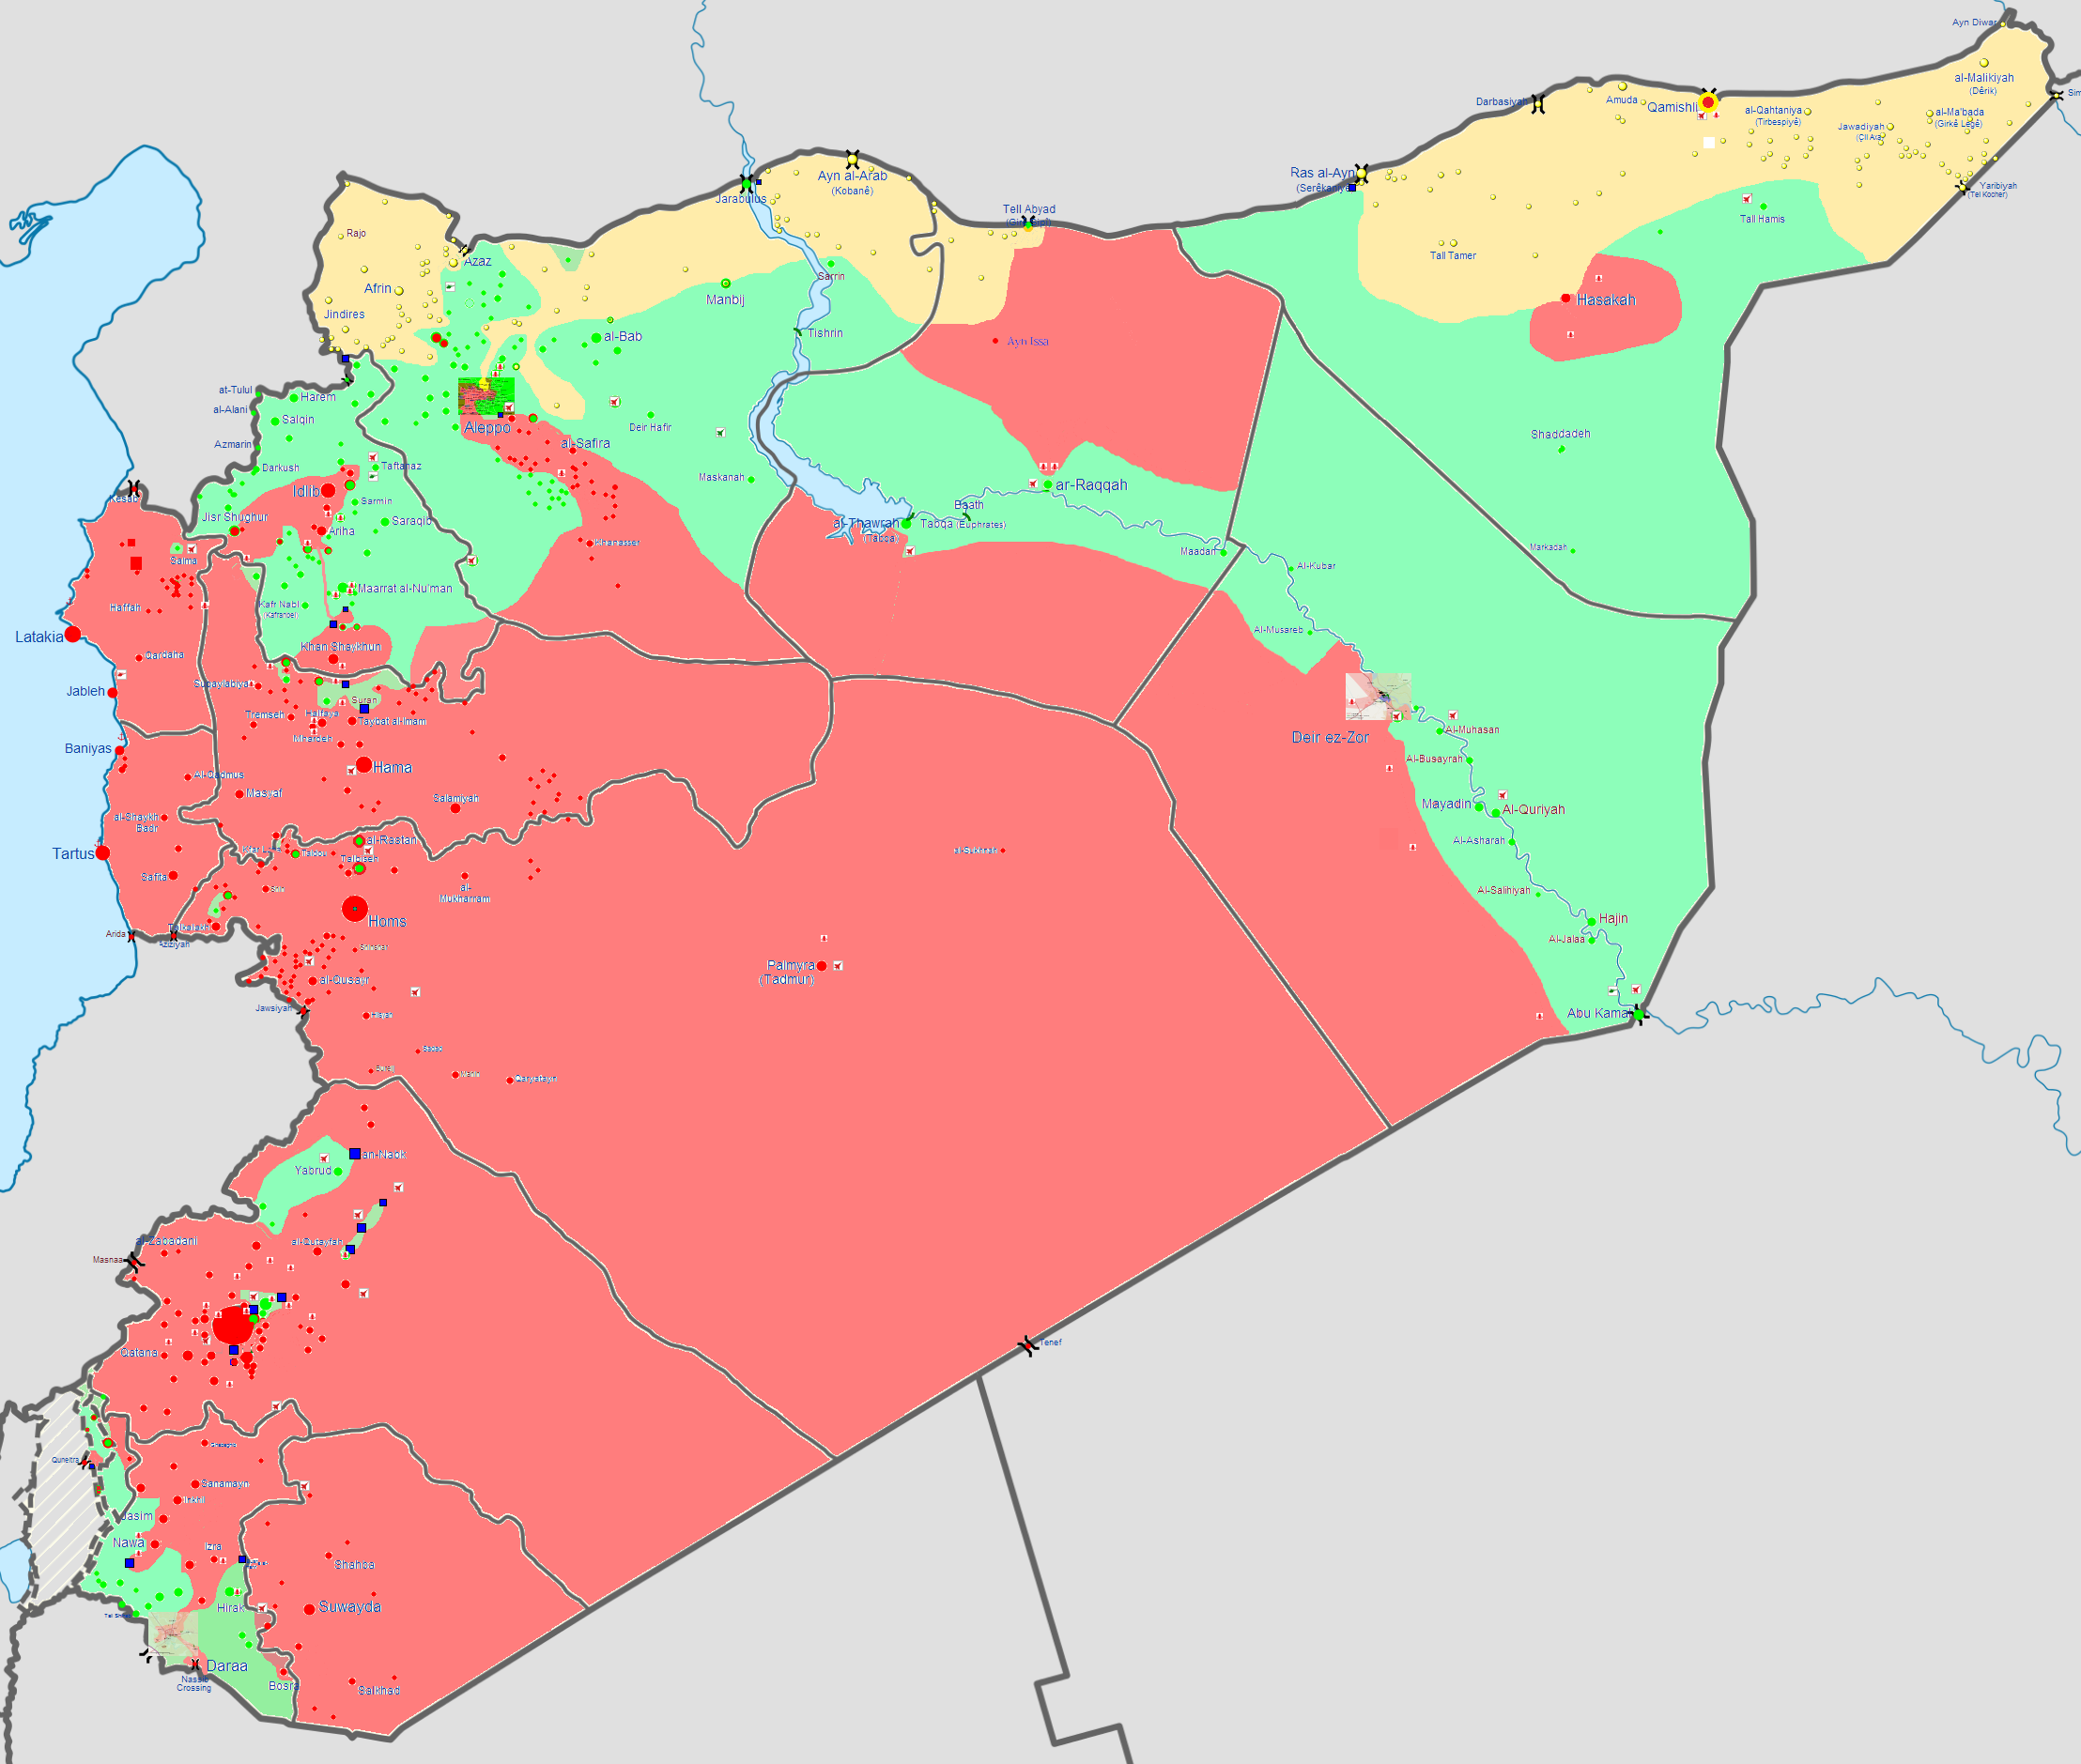
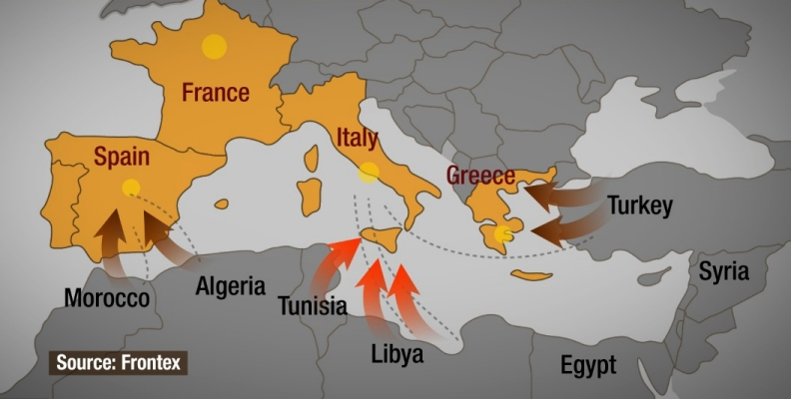

Messaging in disaster situations
War Zones
Refugee crises
Natural Disasters

Slide 9
Transfer over NFC

Slide 10


Slide 11
Offline Communities:
- Can create user base in offline communities
- Virtually impossible to be blocked by governments or bad actors
- Doesn’t require any large scale internet infrastructure to be built

Slide 12
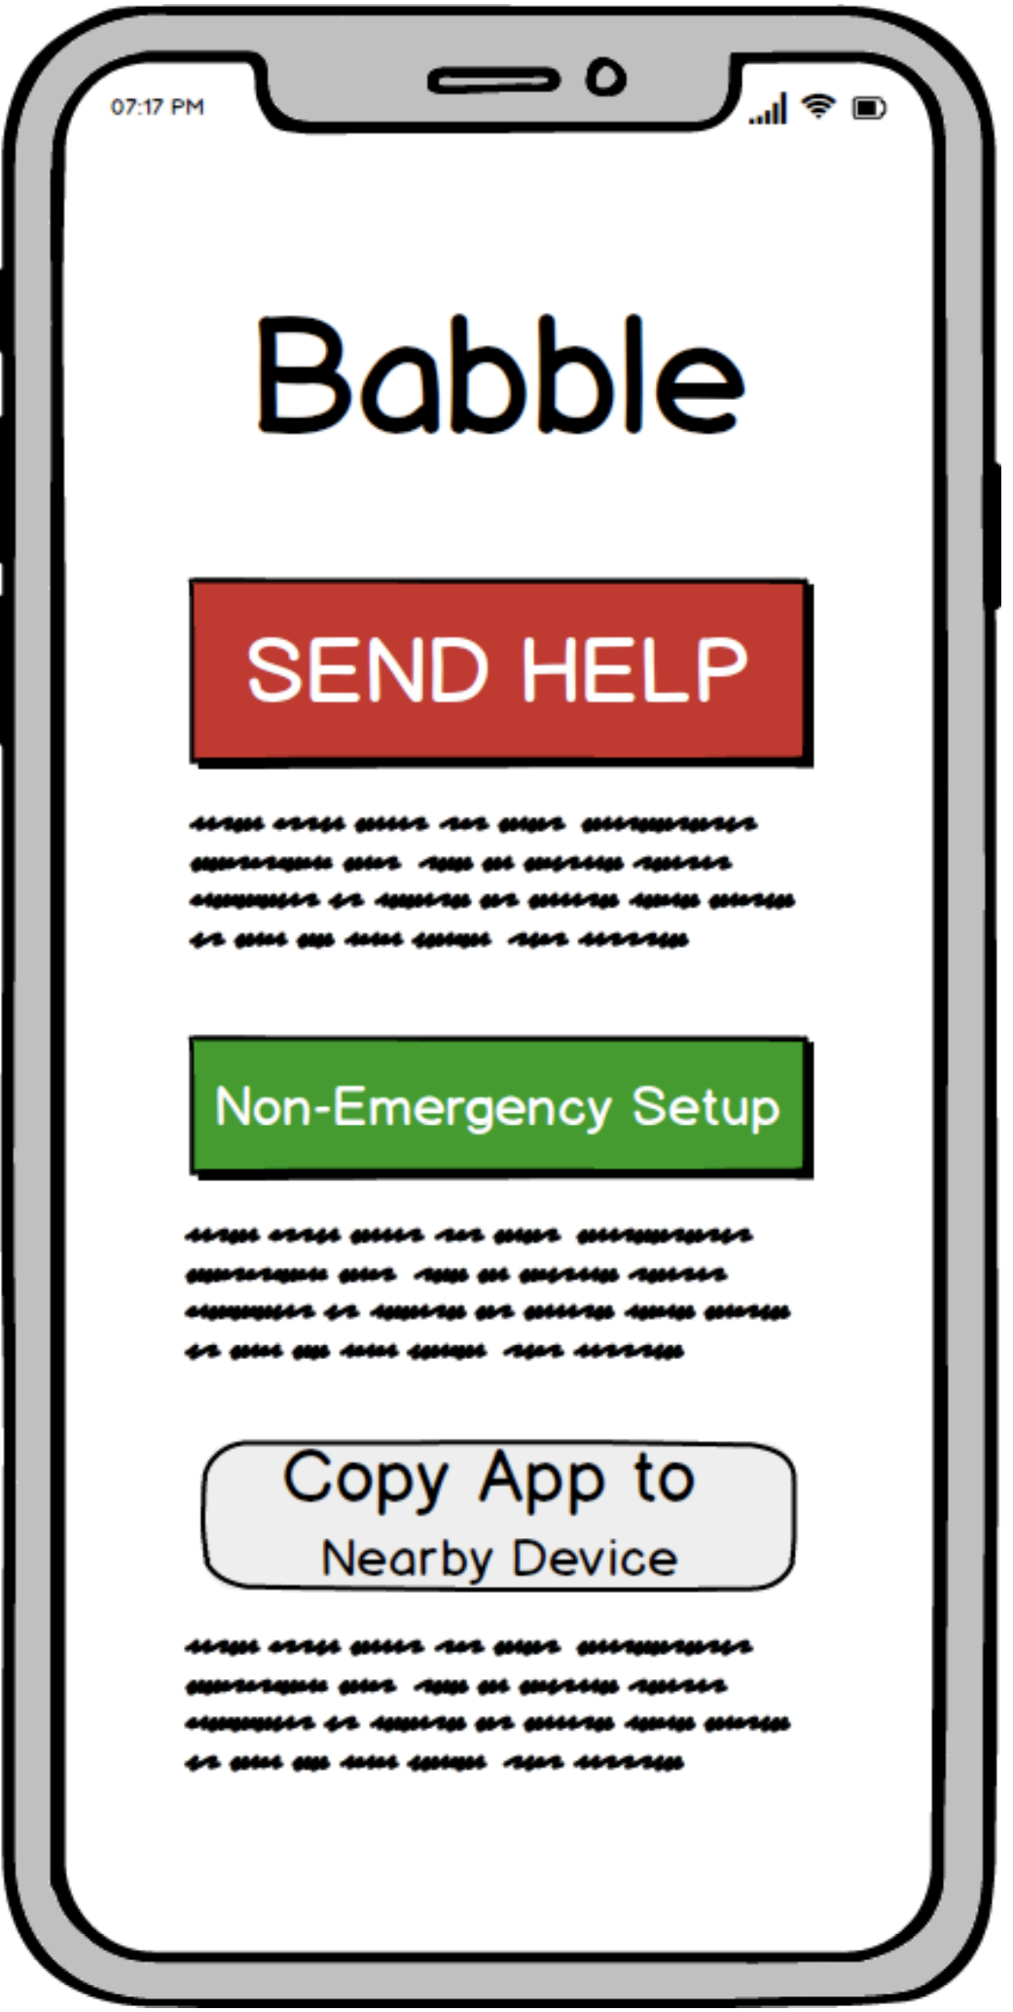
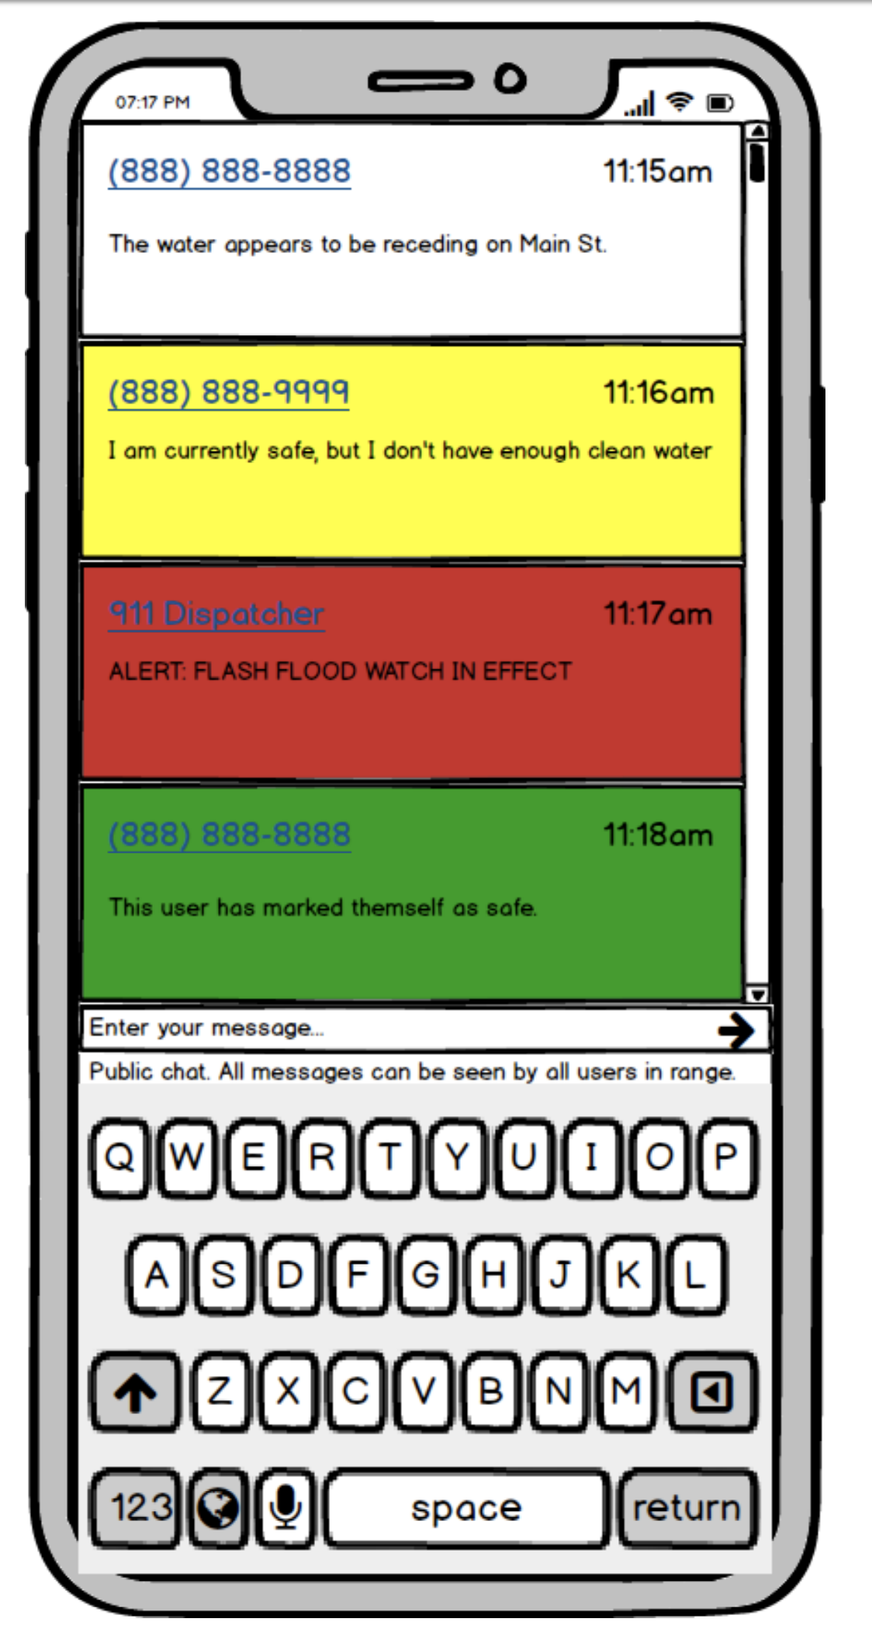
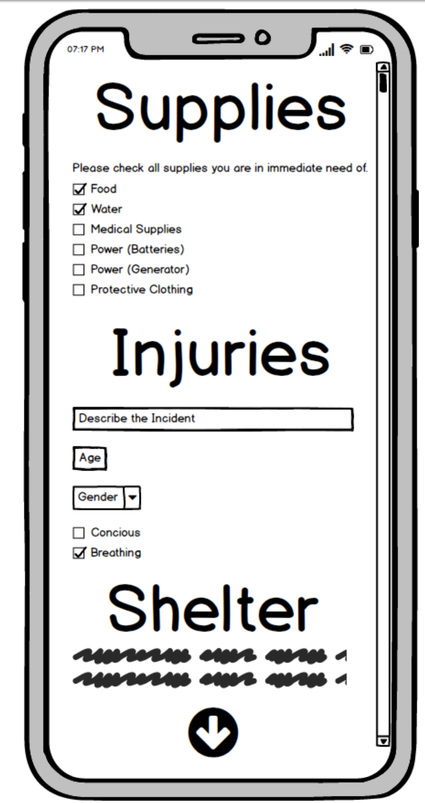
Emergency Situations:
- Users can signal for help without internet
- Users are able to supply situational information
- Emergency services are able to triage users and respond accordingly

Slide 13



Slide 14



Slide 15
Special Thanks to
- MongoDB
- Mike
- Drew
- Nick
- Google
- Nick
- Neto
We literally couldn’t have done this without you

Slide 16



3Beards2Code

